Slide 1
UltraBS
Development of a software for Bend Stiffener Design Optimization

Slide 2
Introduction
Offshore Oil and Gas Production
Floating Production Vessels
Riser Systems
Riser System Components
The Bend Stiffener
Bend Stiffener Design

Slide 3
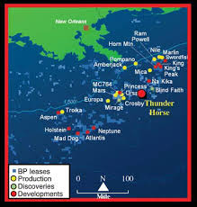
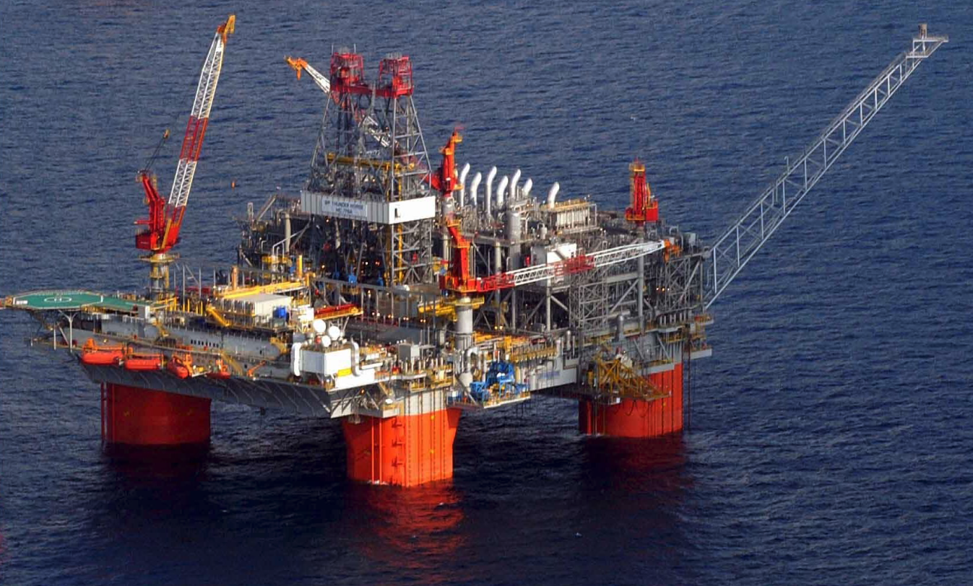
Offshore Oil & Gas Production

Slide 4
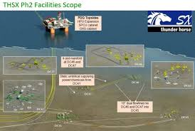
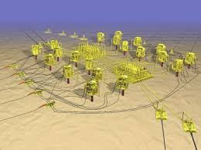
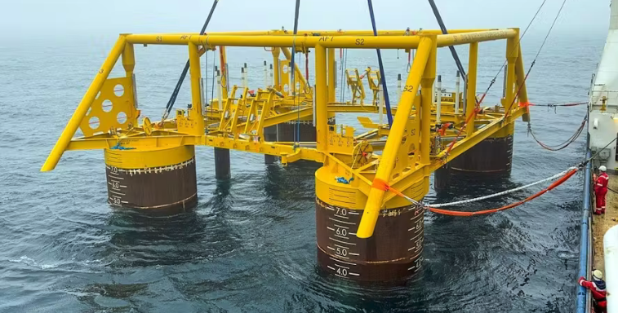
Subsea Oil & Gas Production

Slide 5
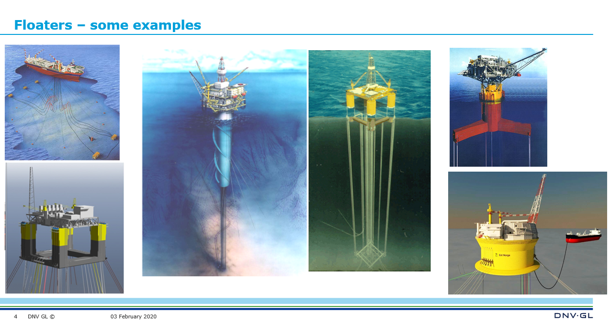
Floating Production Vessels

Slide 6
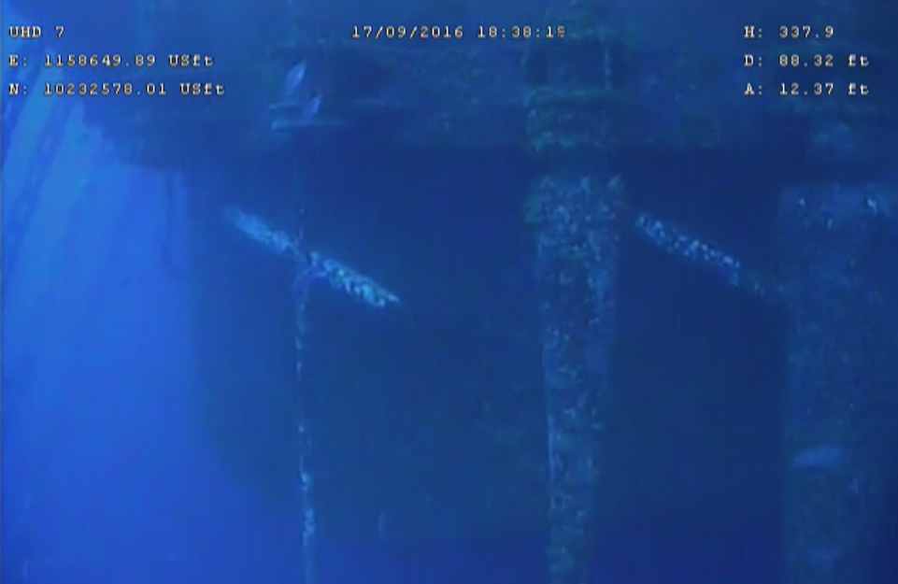
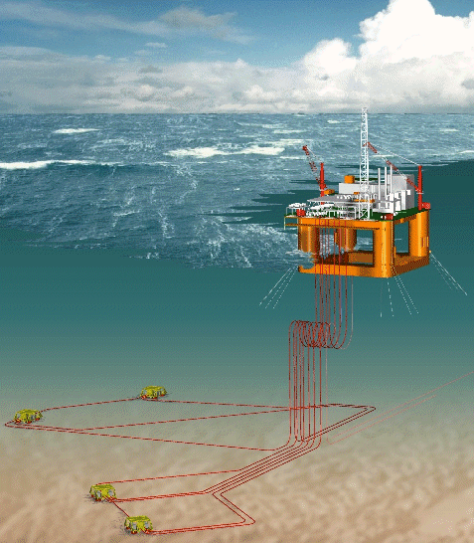
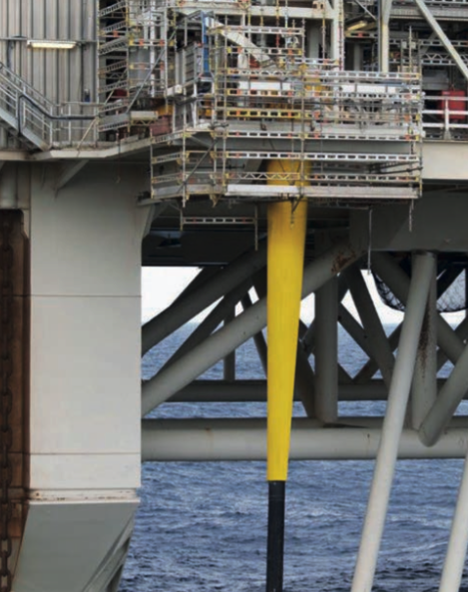
Riser Systems
RISER TYPES:
Oi & gas pipelines
Water injection pipelines
Gas lift pipelines
Control umbilicals
Power cables

Slide 7
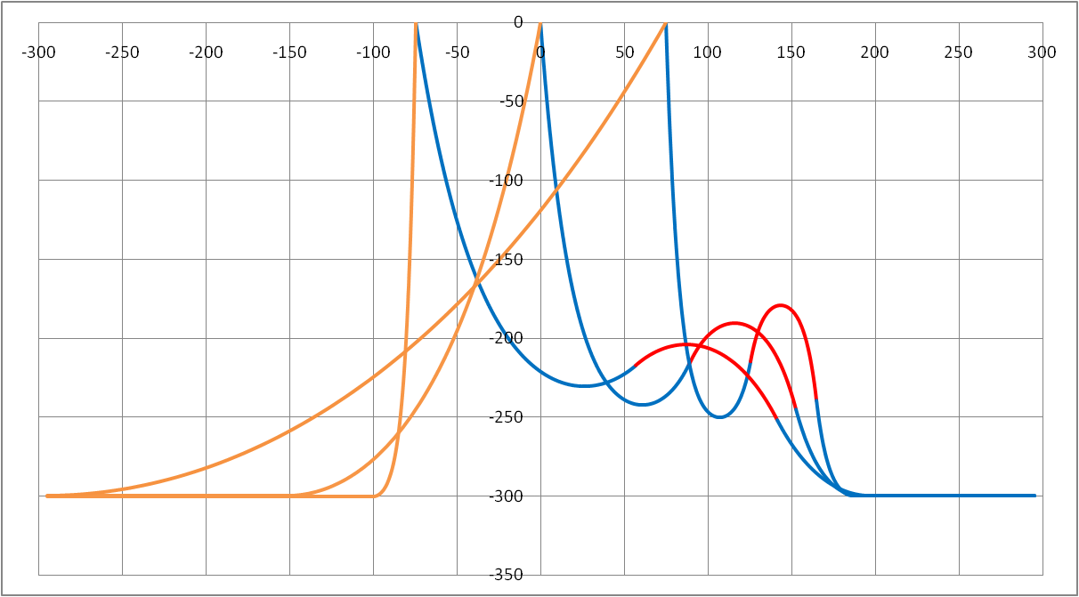
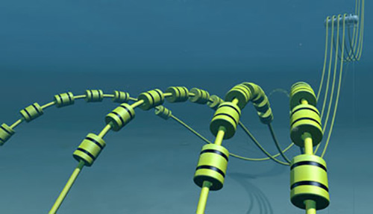
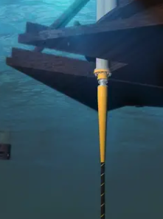

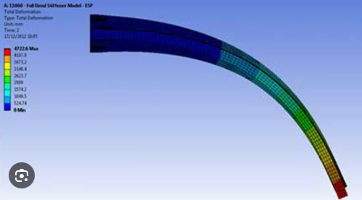
System Components
Buoyancy Modules
Bend Stiffener

Slide 8
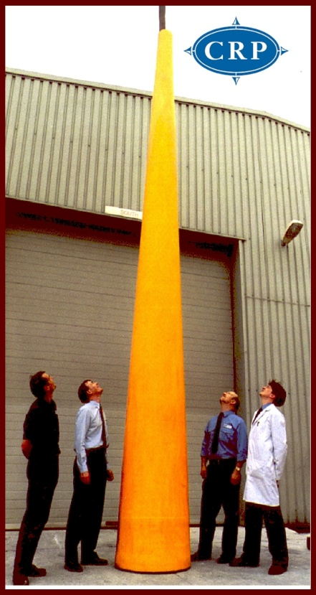
The Bend Stiffener
Bending Protection
Overbending (max allowable curvature)
Fatigue

Slide 9
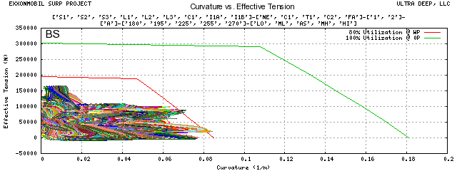
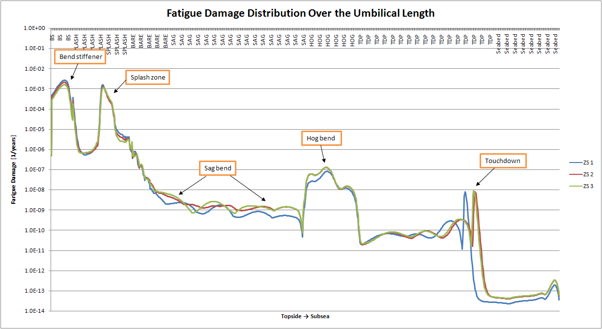
The Bend Stiffener

Slide 10
Bend Stiffener Design
Design Inputs:
The umbilical’s Capacity Curve (allowable combination of tension and bending)
Operational behavior (acting combination of tension and deflection angle)

Slide 11
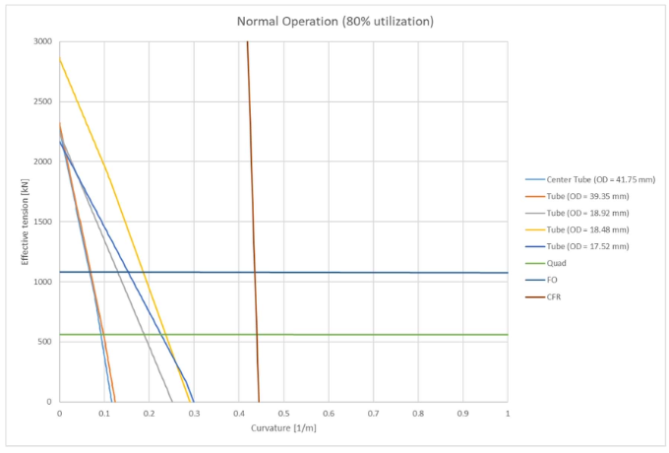
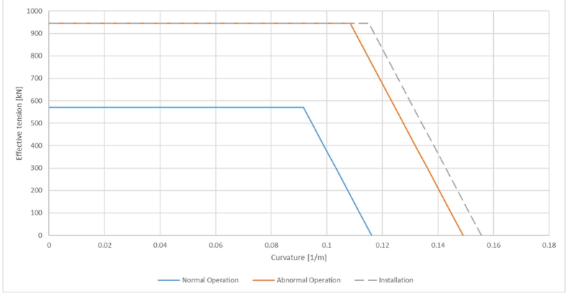
Bend Stiffener Design
Capacity Curve
Based on max allowable stress in the internal components

Slide 12
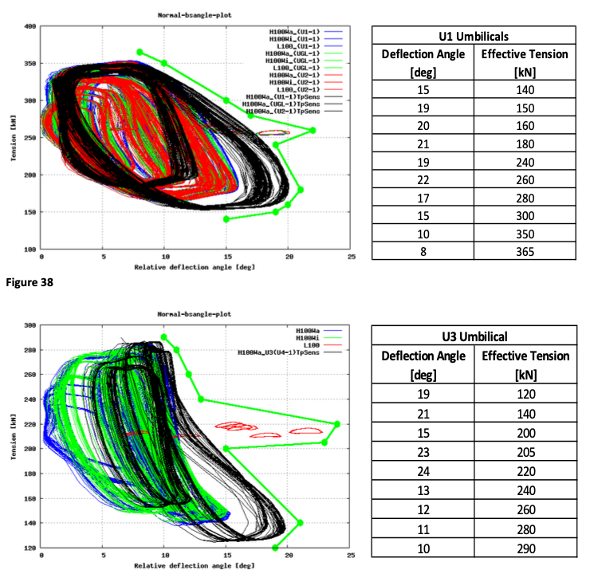
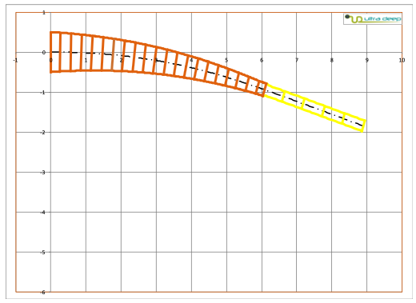
Bend Stiffener Design
Operational behavior

Slide 13
Bend Stiffener Design
Example using the UltraBS method:
Open: “Umbilical Data and Response for BS Design.xlsx”
Goto: “Desktop/UltraBS/Aker” and look at the Python scripts

Slide 14
Bend Stiffener Design
Look at:
“00000-INT-TN-KIE-20170529-1 Rev. 1” p. 14 onwards
”UltraBend DETAILED DESCRIPTION.mmap”
“GUI.pdf”

Slide 15














Clients
300+ projects
CLIENTS
Oil companies
Shell
Helix
Statoil
BP
ExxonMobil
Cobalt
Umbilical manufacturers
Technip Umbilicals (DUCO)
MFX
Nexans
Oceaneering
Parker
Unitech
Engineering/Service companies
Baker Hughes
OneSubsea
DES Operations
Blue Ocean

